Slide 1


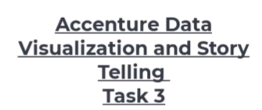
Social
Buzz

Slide 2


Today's agenda
Project recap
Problem
The Analytics team
Process
Insights
Summary

Slide 3

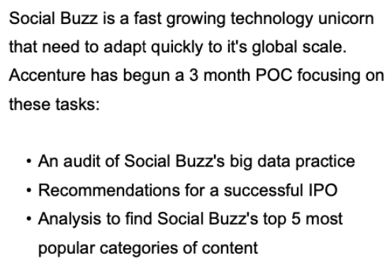
Project Recap

Slide 4

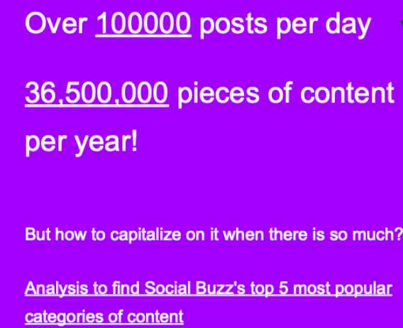
Problem

Slide 5

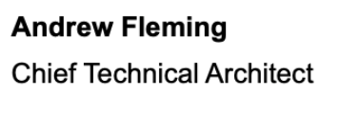

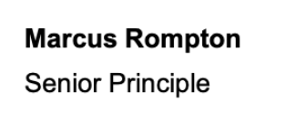

The Analytics team
Narendra Bariha
Data Analyst

Slide 6
Data Understanding
Process
1
Data Cleaning
2
Data Modelling
3
Data Analysis
4
5
Uncover Insight

Slide 7
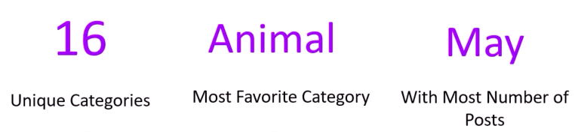



Insights
May
with most number of post

Slide 8
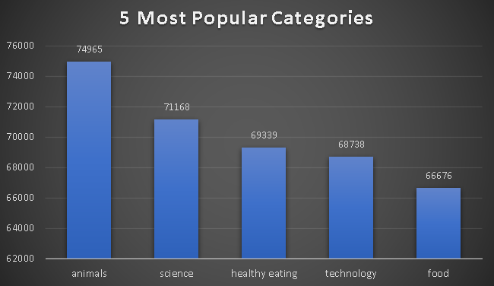

Notes:
The top five content categories by user engagement are Animals (74,965 posts), Science (71,168 posts), Healthy Eating (69,339 posts), Technology (68,738 posts), and Food (66,676 posts). These categories present key opportunities for targeted content campaigns to boost engagement.

Slide 9
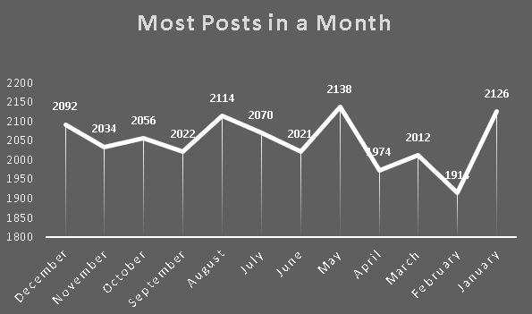
Notes:
The data shows that May has the highest number of posts with 2,138, followed by August with 2,114, and January with 2,126. Other notable months are December with 2,092 posts and July with 2,070. These months show increased engagement, making them ideal for maximizing marketing efforts.

Slide 10
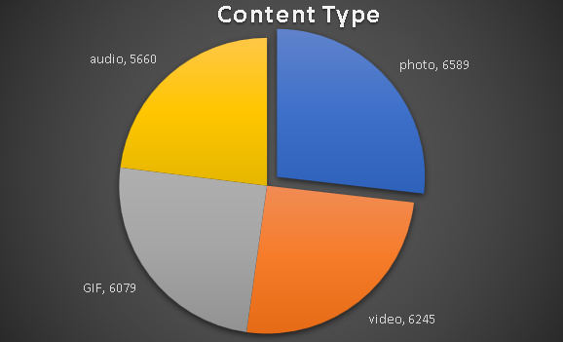
Notes:
The analysis of content types shows clear preferences among users. Photos lead with 6,589 posts, indicating a strong interest in visual content. Videos follow closely with 6,245 posts, reflecting a demand for dynamic and engaging formats. GIFs rank third with 6,079 posts, suggesting users enjoy short, looping animations. Audio content has the least engagement with 5,660 posts. These findings emphasize the need to prioritize photo and video content in future campaigns to align with audience preferences.

Slide 11
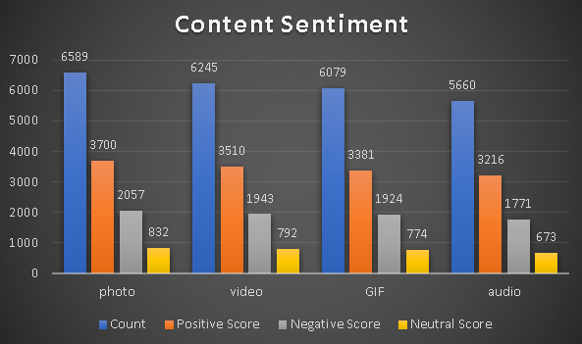
Notes:
The sentiment analysis shows that photos (6,589 posts) have the highest positive score of 3,700, along with a negative score of 2,057 and a neutral score of 832. Videos (6,245 posts) follow with a positive score of 3,510, a negative score of 1,943, and a neutral score of 792. GIFs (6,079 posts) receive a positive score of 3,381, a negative score of 1,924, and a neutral score of 774. Audio content (5,660 posts) has a positive score of 3,216, a negative score of 1,771, and a neutral score of 673. Overall, all content types generate more positive reactions than negative or neutral responses.

Slide 12

Insight :
There are a total of 16 distinct content categories.
Out of which Animal and Science categories are the most popular one.
4 type of content - Photo, Video, Gif and Audio.
Out of which people prefer photo and video.
May month has the highest number of posts.
Conclusion:
Should focus more on the top 5 categories that's animal, technology, science, healthy eating and food.
create campaign to specifically target those audiences.
Need to maximize in the month of January, may and august as they number of posts in these months are the highest.
Summary

Slide 13
Thank you!

